Slide 1
THE ENVIRONMENT & CULTURE OF THE ORGANIZATION
Books covered: Management by Griffin

Slide 2
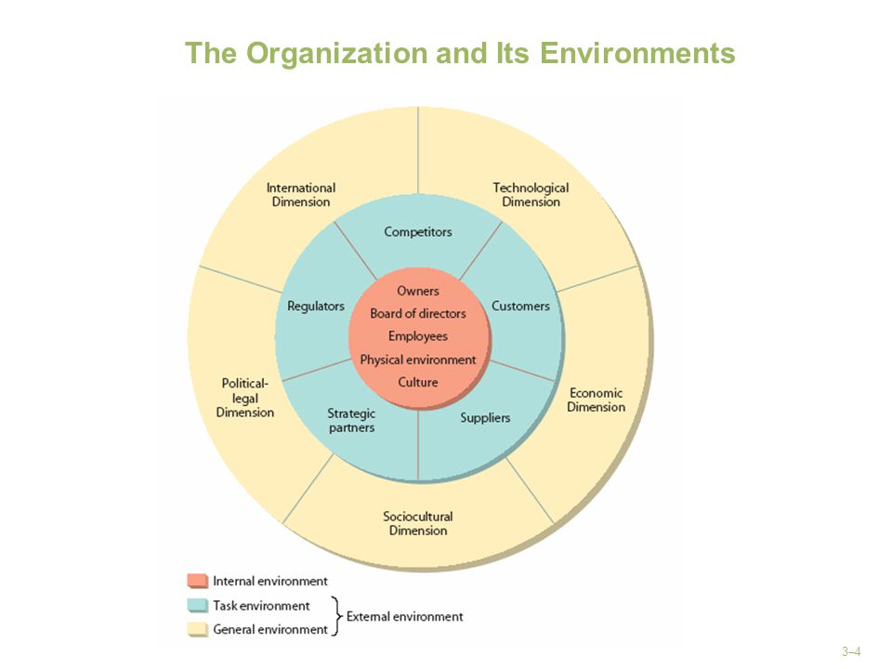
THE ORGANIZATION AND ITS ENVIRONMENT

Slide 3


EXTERNAL ENVIROMENT-GENERAL ENVIROMENT
The set of broad dimensions and forces in its surroundings that create its overall context.
ECONOMIC ENVIROMENT- overall health and vitality of the economic system in which the organization operates, particularly economic growth, interest rates, inflation rate, unemployment.
TECHNOLOGICAL ENVIRONMENT- i.e. Managers frequently claims that electronic communications reduced the time to reach customers and speeds up responses to customer inquiries. The managers also indicates that e-business processes helps reduce the cost of material and personnel involved in paper-based communications both within and outside the business unit. As access to mobile broadband becomes widespread and less expensive, it is potential as an enabler for the creation and development of small business increases. While social network technology does not appear to result in firm growth directly, the use of social networks and other forms of technology is necessary for growing firms.
SOCIO-CULTURAL DIMENSION- As society and culture change, businesses must adapt. Like changing consumer preferences. What was popular and fashionable 20 years ago may not be popular today or 10 years down the road.

Slide 4


EXTERNAL ENVIROMENT-GENERAL ENVIROMENT
4. POLITICAL LEGAL ENVIROMENT- First, legal environment decides what a business can or cannot do. Second, pro or anti business sentiment influences business activity. Third, political stability has ramifications for planning. I.e. The government of India on Monday announced the ban of 59 Chinese apps in the country.
5. THE INTERNATIONAL DIMENSION- The extent to which an organization is involved in or affected by business in other countries.

Slide 5

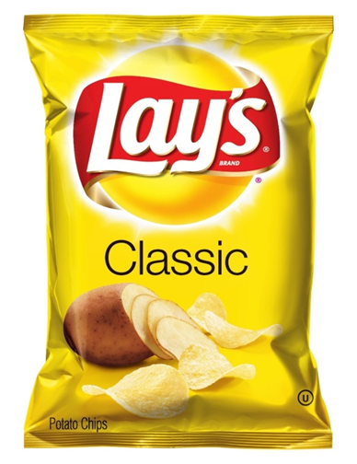
THE TASK ENVIRONMENT
COMPETITORS-competing for customer dollars. Competition can occur directly or indirectly. Competing for bank loans.
CUSTOMERS-customers can be individuals, institutions or government. Dealing with customers is becoming increasingly complex.
SUPPLEIRS- organizations that provide resources for other organizations.
STRATEGIC PARTNERS- two or more companies that work together in joint ventures or other partners.

Slide 6
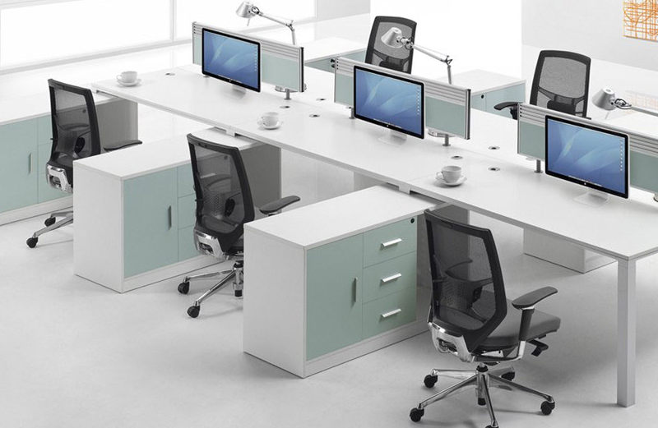

THE INTERNAL ENVIRONMENT
OWNERS-can be a single individual who establishes and runs a business, partners who jointly owns a business or individuals who buy stocks.
BOARD OF DIRECTORS-A board of directors is essentially a panel of people who are elected to represent shareholders. Every public company is legally required to install a board of directors; nonprofit organizations and many private companies – while not required to – also name a board of directors.
EMPLOYEES- Major elements of an organization. Workers can be full time or part time.
THE PHYSICAL WORK ENVIRONMENT-Office employees spend a lot of their time inside a building, where the physical environments influence their well-being and directly influence their work performance and productivity. In the workplace, it is often assumed that employees who are more satisfied with the physical environment are more likely to produce better work outcomes. Temperature, air quality, lighting and noise conditions in the office affect the work concentration and productivity. Numerous studies have consistently demonstrated that characteristics of the physical office environment can have a significant effect on behavior, perceptions and productivity of employees.

Slide 7
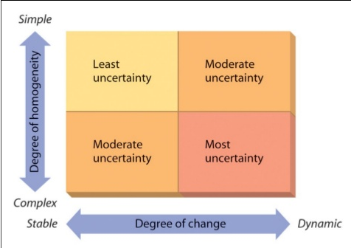
Organization-environment relationships
Environmental change and complexity: James D. Thompson (1967) was one of the first people to recognize the importance of the organization's environment. Thompson suggests that the environment can be described along two dimensions. Its degree of change and its degree of homogeneity.
The degree of change is the extent to which the environment is relatively stable or relatively dynamic.
The degree of homogeneity is the extent to which the environment is relatively simple (few elements, little segmentation) or relatively complex (many elements, much segmentation).

Slide 8
Organization-environment relationships
Environmental change and complexity
Least uncertainty-restaurant business. Certain segment of consumer, limited product line, stable suppliers.
Moderate uncertainty- Clothing industry. Though customer base is simple but their taste is always changing.
Moderate uncertainty- car industry. Car’s design is not radically changing but lots of different suppliers, regulators, customers group.
Most uncertainty- the environment is constantly changing and has a large number od elements to deal with. Example the software industry.

Slide 9
Organization-environment relationships
Although Thompson's general classifications are useful and provide some basic insights into organization - environment interactions, in many ways lack the precision needed by managers who must deal with their environments on a day-to - day basis.
Michael E. Porter (1980), a Harvard professor and expert in strategic management, has proposed a more refined way to assess environments. In particular, he suggests that managers need to view the environment of their organizations in terms of five competitive forces.
The threat of new entrants is the extent to which new competitors can easily enter a market or market segment i.e. barriers to entry.
Competitive rivalry is the nature of the competitive relationship between dominant firms in the industry. For example, in the mobile phone industry, GP and Robi have often engaged in intense price wars, comparative advertising, and new product introductions.
The threat of substitute products is the extent to which alternative products or services may replace or diminish the need for existing products or services. For example the advent of computers, smartphones has reduced the demand for calculators as well as for typewriters, camera. Services like Dropbox and Google Drive are substitute to storage hardware drives. The threat of a substitute product or service is high if it offers a value proposition that is uniquely different from present offerings of the industry.
The Power of buyers is extent to which buyers of the products or services in an industry have the ability to influence the suppliers.
The power of suppliers is the extent to which suppliers have the ability to influence potential buyers. For example Kenya Power and Lighting is the only company supplying electricity in Kenya. Subject to state regulation, it can therefore charge what it wants for its product, provide service at its convenience, and so forth.

Slide 10
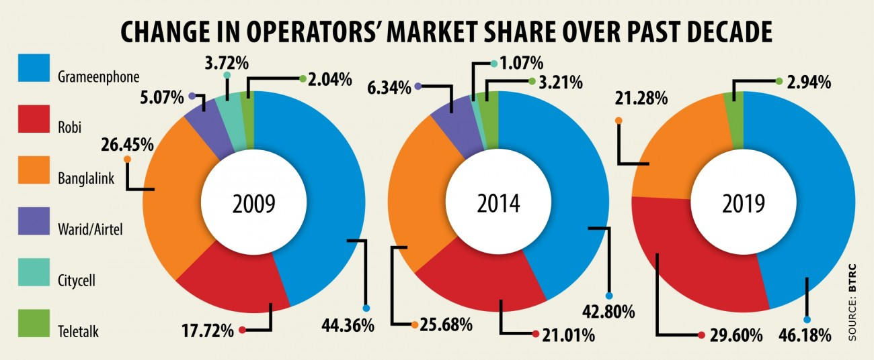

Slide 11
Organization-environment relationships
Environmental Turbulence-Although always subject to unexpected changes and upheavals, the five competitive forces can be studied and assessed systematically and a plan can be developed for dealing with them. At the same time, though, organizations also face the possibility of environmental change or turbulence, occasionally with no warning at all.

Slide 12

Building effective time management skill
High priority-that must be addressed that day.
Moderate priority-that should be addressed but could be postponed if necessary
Low priority- those that can easily be postponed

